Slide 1

Where Arabic and English Intersect
Qatar University – Foundation Program
May 12, 2020
Judy Thompson

Slide 2
Agenda
Language Learning and Patterns
Arabic And English Sounds
The Six Patterns to spoken English

Slide 3
How the Brain Learns
Attach new information to information it already knows – first language is an ideal starting place for learning a second language
Pattern-seeking, meaning-making machines

Slide 4
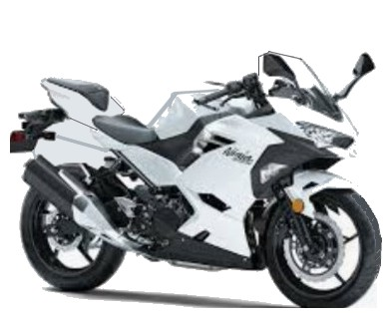
Pattern For Driving
How do I make it GO
How do I make it STOP
How do I STEER it

Slide 5
Patterns for Speaking English
Sounds
Pronunciation
Words
Sentences Conversation
Connecting
Expressions - Fluency
Non-verbal

Slide 6
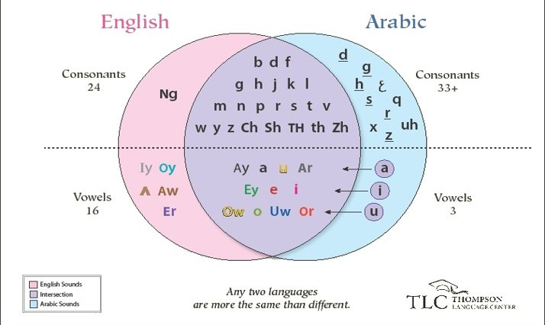
Sounds of English and Arabic

Slide 7
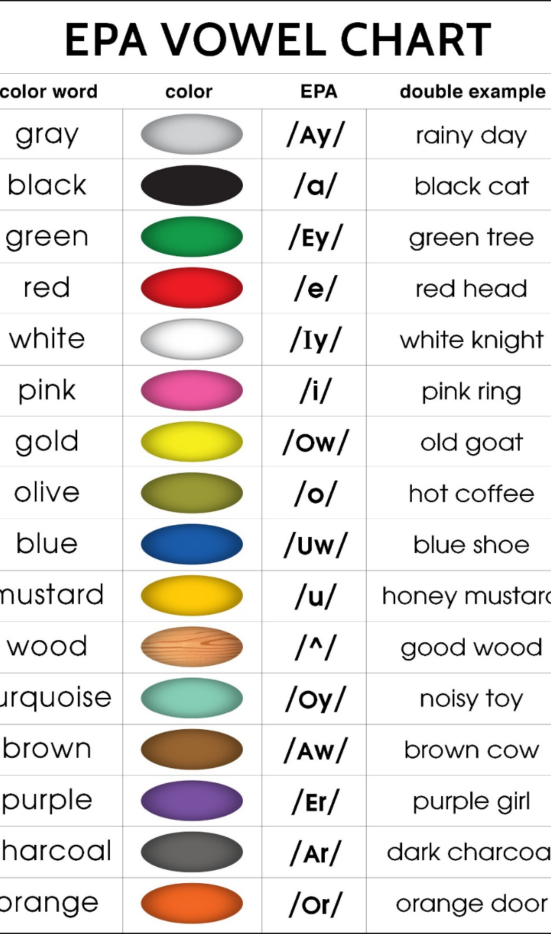
The English Phonetic Alphabet
As found in:
English is Stupid, Students are Not
How Do You Say?
Backpacker’s English: Cracking the Code Pronunciation

Slide 8
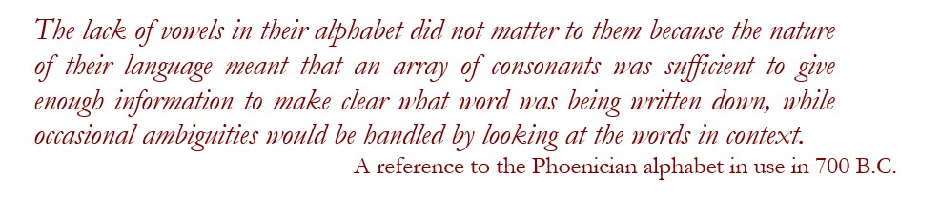
Interesting but Not Important
TTYL - talk to you later
LMK – let me know
LOL – laugh out loud
IMHO – in my humble opinion

Slide 9
Conversation
Words
The biggest problem for English Learners is Spelling doesn’t make sense. The reason alphabets exist is to write the sounds of a language down so people who have heard it can spell it and people who can read it can pronounce it.
This never happened with English. English was spoken for 1000 years, was a combination of German, Norse and French and used 40+ sounds before William Caxton wrote it down with only 26 letters (ABC) and made a mess. We copy his spelling mistakes to this day. Over 400 years!
Spelling is random, sometimes letters are silent… every letter in English is silent sometimes. Sometimes letters are pronounced that aren’t written down – Invisible consonants.
Basically, you can’t learn to speak English from reading it.

Slide 10
Which Word Groups Rhyme?
RED, HEAD, SAID
TO, DO, GO, NO
NEW, FEW, SEW, DEW
HAIR, THERE, FARE, BEAR
TWO, DUE, KNEW, SHOE, WHO, THROUGH

Slide 11
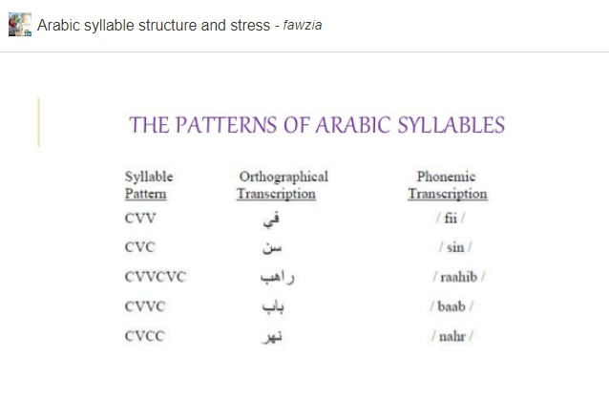

Slide 12
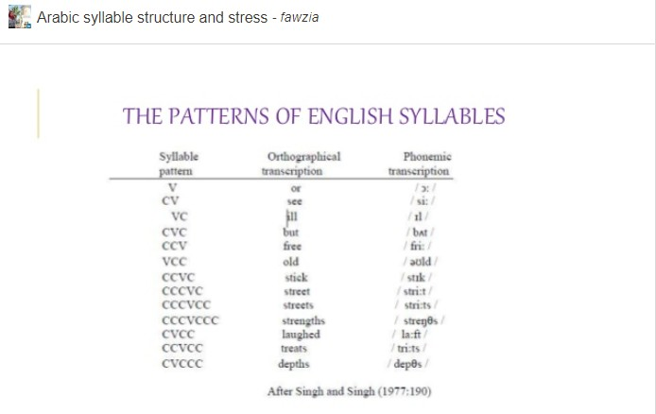

Slide 13
What you Need to Know about Speaking English is
Listening and Word Stress
Vowel sounds dictate syllables – stretch 1, idea 3 – clap it out
There is one and only one most important STRESSED syllable in any word that is higher, louder, longer than the others
The meaning of the word is in the stressed syllable content content
If the word stress is wrong or missing you are unintelligible
banana - bu NA nu
Native English speakers have infinite tolerance for accents, sound substitutions and grammar mistakes but
zero tolerance for word stress errors

Slide 14
Conversation
Sentences
Sentence Stress is the same as Word Stress, some words are important and some are not
MICE EAT CHEESE
the MICE EAT CHEESE
the MICE EAT the CHEESE
the MICE will EAT the CHEESE
the MICE have EATen the CHEESE
the MICE will have EATen the CHEESE

Slide 15
Conversation
Connecting - Linking
1. Consonant Consonant
bus _ stop bu stop
2. Consonant Vowel
turn _ off tur noff
3. Vowel Vowel
go _ away go waway

Slide 16
All Words Start with Consonants – like Arabic!
Can I have a bit of egg
ca ni ha va bi da vegg
* Titanic Song, ABC

Slide 17
Conversation
Recap
Words – Word Stress is EVERYTHING in English – one syllable higher longer louder
Sentences – Same, some words are important and some are not
Do you want to get a cup of coffee? (Arabic word)
Jawanna gedda cuppa COffee?
Or COffee?
Connecting words – All interior words begin with consonant sounds

Slide 18
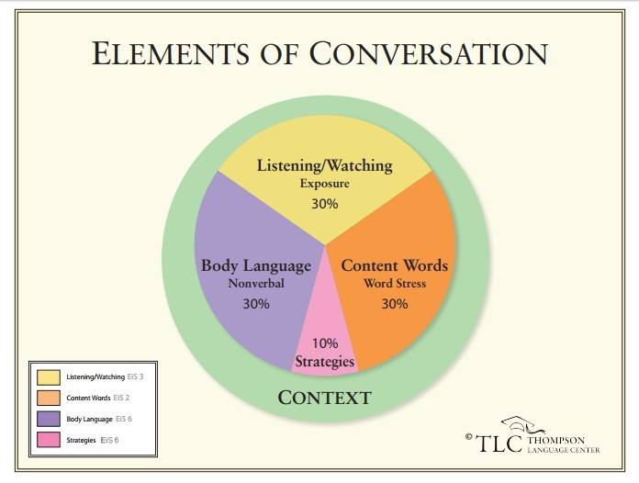

Slide 19
Fluency
Expressions
My students call Fluency the other level which I love.
I call it Brain Leap.
Rita Baker calls it ‘abstracting’ or taking a quality of a concrete word, situation or gesture and using it to express a complex idea.
Grammar and learners are linear or two-dimensional, but fluency is three. Learners know what red means and eye means but they don’t know what the red eye is and they can’t guess. (midnight flight)
There are techniques for teaching students to read the clues for the other level and how to interpret them. But I’m not doing that now.
There are expressions in every language, some are in many. (Arabic)
The resource book of expressions for learners organized by the colors on the vowel chart, is How Do You Say? It’s available on Amazon.

Slide 20
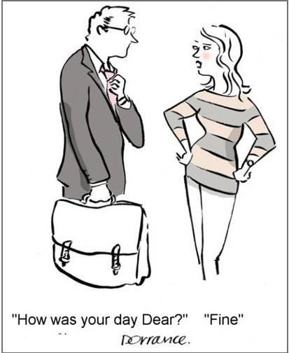
Fluency
Non-Verbal Communication
Some say it’s 80% of the message
Some of it is cultural, how close to, how do I know when it’s my turn to talk, how much silence is acceptable before you repeat your question…
Voice qualities play a big role, low voice bad, high voice good…

Slide 21
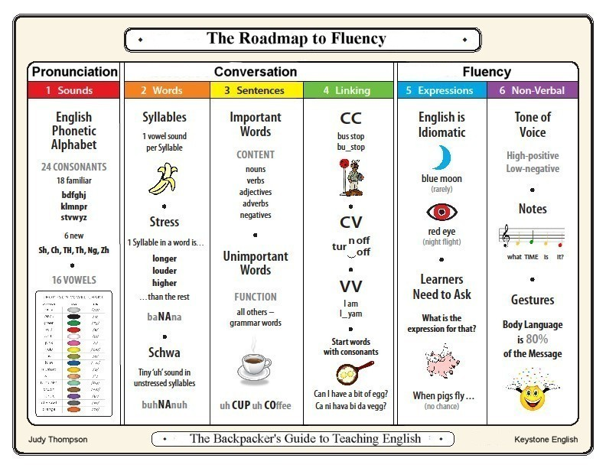
Stop, Go, Left and Right
Patterns for Driving English

Slide 22
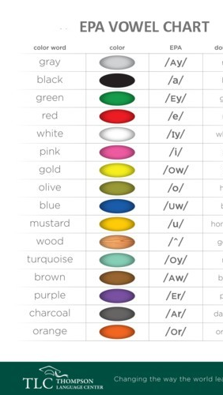
5 of the 6 English Speaking Patterns are in the EPA Vowel Chart
Pronunciation - classified by sound not spelling
Word Stress - indicated by the color of each word (JUdy is Blue)
Sentence Stress – the same staggered important/unimportant array as syllables
Linking - words end in long vowels not short ones, the w and the y are included in the EPA spelling on the chart
Expressions – start with color expressions as a gateway to the other level

Slide 23
Where Arabic and English Intersect
Consonant sounds are the same, Arabic has more
Arabic spelling is better
English has borrowed (stolen) many words from Arabic
Word stress is different in English and in English it’s the single most critical element of intelligibility
English syllables and words are crazy but every internal syllable and word begins with a consonant, like Arabic
I don’t know where Arabic and English expressions intersect but you do
Body language is a function of culture again, you know more than me.

Slide 24
I’m Judy Thompson
Thank you for listening
It was an honor to speak at the Foundation Program Virtual Conference. Thank you.
Many, many thanks to Anwar Alfetlawi who put my name forward, to Ahmad Hazratzad for all his help and to all the organizers. It’s a great event.
Email me if you have any questions:
judy@thompsonlanguagecenter.com
or through the website www.backpackersenglish.com
I wish you and your families well.
Good day.

