Slide 1
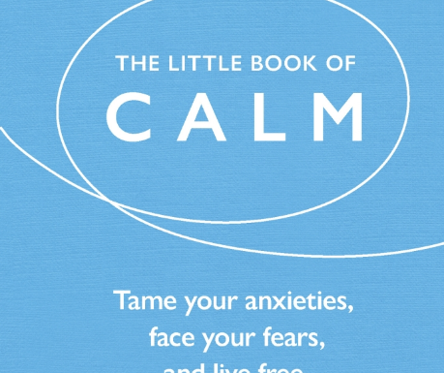
Grounded Mind: Where mindfulness and emotional intelligence meet.
Dr. Aaron Balick, Psychotherapist
Honorary Senior Lecturer Department of Psychosocial and Psychoanalytic Studies, Essex University UK
Director of Stillpoint Spaces International
Media contributor and consultant
Organisational consultant
Author of The Little Book of Calm
Notes:
Self regulation

Slide 2
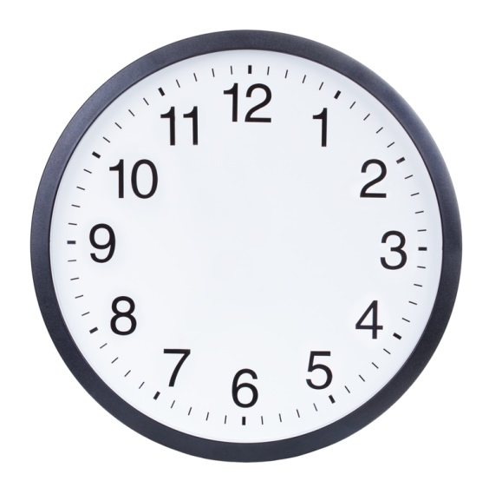
One Moment
Notes:
Close eyes. Take one moment. Write down everything that came up in that moment. Was it long? Was it short? Was it full or empty? How did you feel? Discuss with table.

Slide 3
Monkey Mind
Notes:
Insight, getting to know the self. The basis for emotional intelligence.

Slide 4
Applied psychology
Drawing on the research and experience with high intensity clinical work with individuals – and applying it outside the consulting room.
Notes:
Originates from pathology, or when things go wrong. Issues of body language, unconscious communication, and awareness.

Slide 5
Mindfulness
“The capacity to be fully aware of all that one experiences inside the self – body, mind, heart, spirit – and to pay full attention to what is happening around us – people, the natural world, our surroundings and events.”
- Richard Boyatzis

Slide 6
Emotional Intelligence
“The ability to monitor one’s own and others’ feelings and emotions, to disseminate among them and to use this information to guide one’s thinking and actions.”
- Peter Salovey and John Mayer
“Managing feelings so that they are expressed appropriately and effectively, enabling people to work together smoothly toward their common goals.”
- Daniel Goleman

Slide 7
Damasio’s Lawyer
What is your data set?
It’s not just cognitive.
Notes:
All cognitive function working perfectly - no capacity to be aware of what he desires. Discovered while booking for the next meeting.

Slide 8
What is Mindfulness?
“Mindfulness is awareness that arises through paying attention, on purpose, in the present moment, non-judgementally”
- Jon Kabat Zin

Slide 9
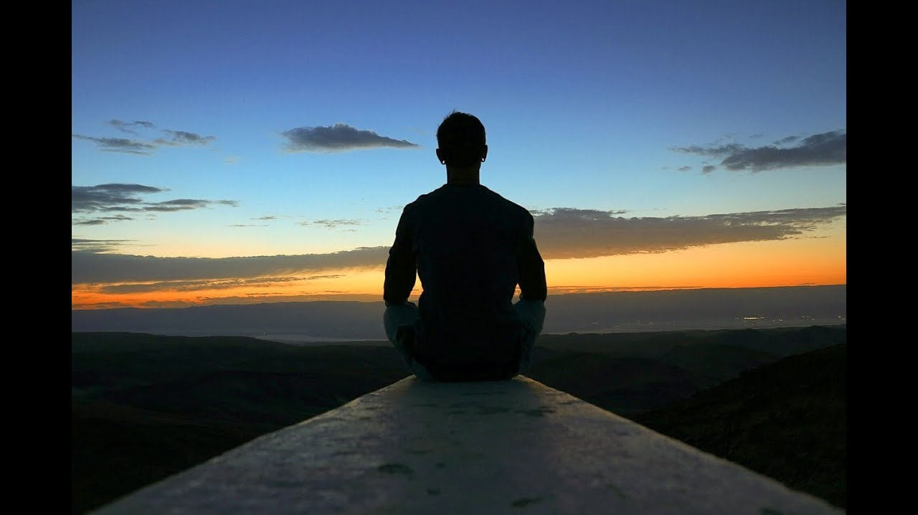
What is Mindfulness?
Paying Attention.
Being Present.

Slide 10
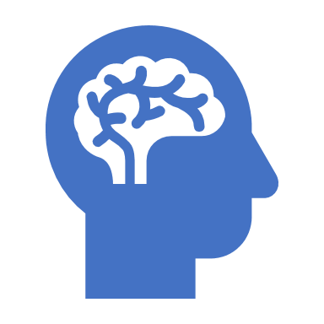
Mindfulness: consequences for self
Greater awareness
Creates a buffer (less reactive)
Less dependent on external factors to develop self-esteem

Slide 11
Mindfulness: consequences for relationships
More satisfying relationships
Better at communicating
Less troubled by interpersonal conflict (less reactive)
- Less likely to dwell on past conflict
- Better able to reduce defensiveness and aggressiveness

Slide 12
Regular Mindfulness Meditation: Physical Consequences
Increase blood flow
Decrease in blood pressure
Protective against hypertension and cardiovascular disease.
Fewer hospital admissions for heart disease, cancer, and infectious diseases.
Half the doctor visits of non-meditators.
Reduction in addictive behaviour including alcohol caffeine, and prescription and illegal drugs.

Slide 13
Regular Mindfulness Meditation: Psychological Consequences
Less likely to experience depression and anxiety.
Less neurotic and report greater feelings of wellbeing and life satisfaction.
Recover from bad moods more quickly – able to let negative thoughts go more quickly.

Slide 14
Harvard Business Review
“Mindfulness should no longer be considered a “nice to have” for executives. It’s a “must have”: a way to keep our brains healthy, to support self-regulation and effective decision making capabilities, and to protect ourselves from toxic stress.”

Slide 15
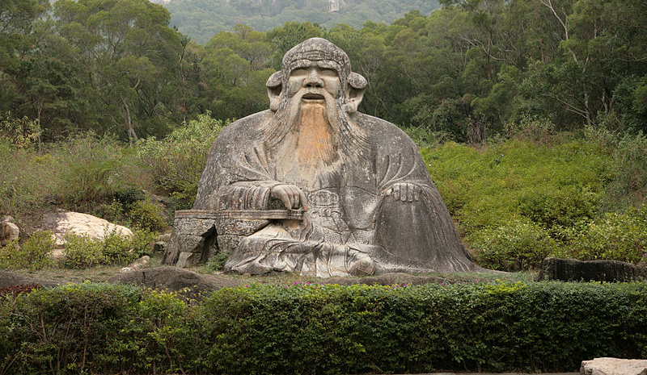
The Present Moment
“If you are depressed you are living in the past. If you are anxious you are living in the future. If you are at peace you are living in the present”
- Lao Tzu

Slide 16
Formal Practice
Sitting – comfortable and alert
Breathing in through the nose and out through the mouth 2 or 3 times.
Breathe normally. Allow thoughts and feelings to arise, and letting them go.
Gently bringing your attention back to the breath all the time.

Slide 17
One Mindful Moment
Notes:
Close eyes. Take one moment. Write down everything that came up in that moment. Was it long? Was it short? Was it full or empty? How did you feel? Discuss with table.

Slide 18
How was that different from the last minute?
Notes:
There are many ways to mindfully meditate, find the one that works for you.

Slide 19
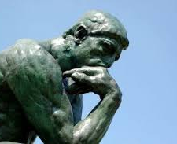
What is Emotional Intelligence?
Self awareness
Self management
Social awareness
Relationship management

Slide 20
Emotional Intelligence
Research carried out in 2001 concluded that 85% of difference between star performers and average performers was attributable to emotional intelligence (over cognitive abilities and technical expertise).
- Goleman

Slide 21
Bringing it together: Mindfulness meets Emotional Intelligence

Slide 22
Put on your oxygen mask first!

Slide 23
Self Awareness
“Self awareness is a neutral mode that maintains self-reflectiveness even in the midst of turbulent emotions.”
- Daniel Goleman
Emotional Communication System (ECS)
How do you know when you’re stressed?
What are your triggers or stress signatures?
What makes you reactive?
Notes:
Honest about strengths and weaknesses, clear about goals, comfortable with self.

Slide 24
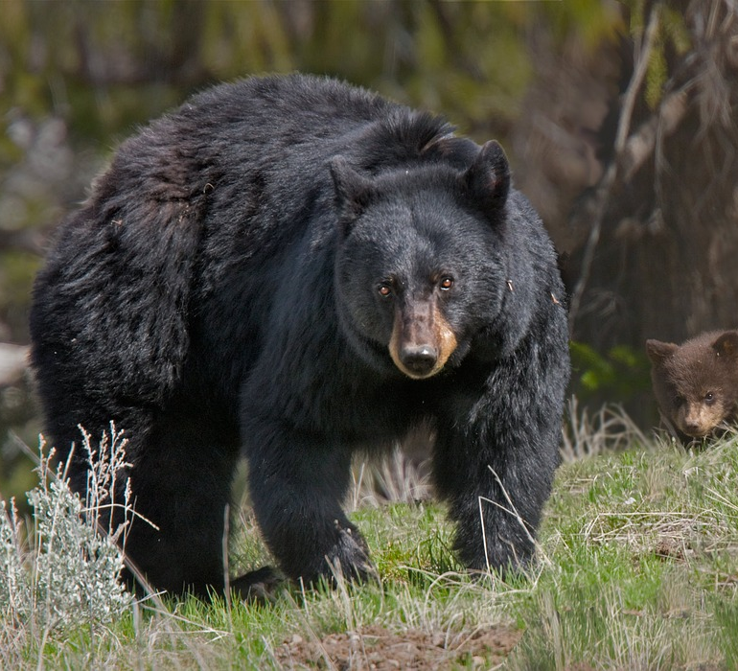
Evolutionary Psychology
Notes:
Fight flight or freeze

Slide 25
Mind your amygdala

Slide 26
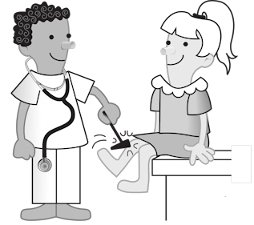
Managing Reactivity

Slide 27
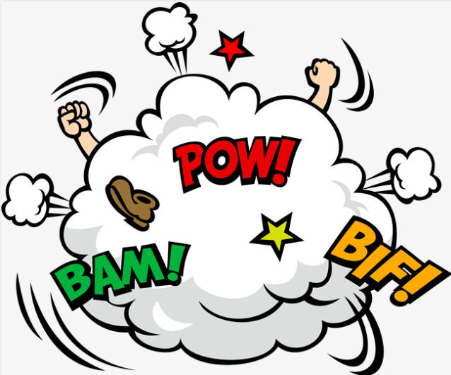
Hijacking the Amygdala

Slide 28
Stimulus
System
Response

Slide 29
Trigger identification
Check your ECS
- shallow breathing, rapid heartbeat, butterflies in stomach
- fight/flight/freeze
Check your thinking
- thoughts of blame, attack, or self- victimising
- ”freaking out” finding it difficult to focus

Slide 30
Come down off a trigger
Notice
Stop
Breathe
Reflect
Respond
Notes:
Imagine, as an exercise, the kindest most generous response. Then choose a response.

Slide 31
What is “identification”?
Observing Ego

Slide 32
Stimulus
System
Response
Emotional Communication System (ECS)
Having trouble? Disconnect and re-attach.

Slide 33
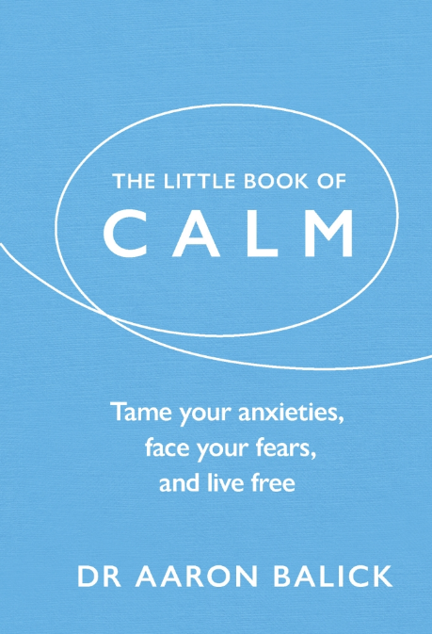
Twitter/Instagram: @DrAaronB

